Slide 1


Nagoya compliant in practice at RBINS
1-02-2019
CEBioS
Han de Koeijer, programme officer CHM/ABS-CH
CEBioS Programme
OD Nature
Royal Belgian Institute Natural Sciences- Belgian Cooperation for Development (DGD)
http://cebios.naturalsciences.be

Slide 2
NP Compliant
Advise to visiting researchers and own
Obtain PIC and MAT before collecting
Let Focal point NP from country of origin post PIC and MAT on the ABS CH
NP documentation linked to the specimen in collections
Ensure documentation easily accessible before permitting use of the specimen/material

Slide 3
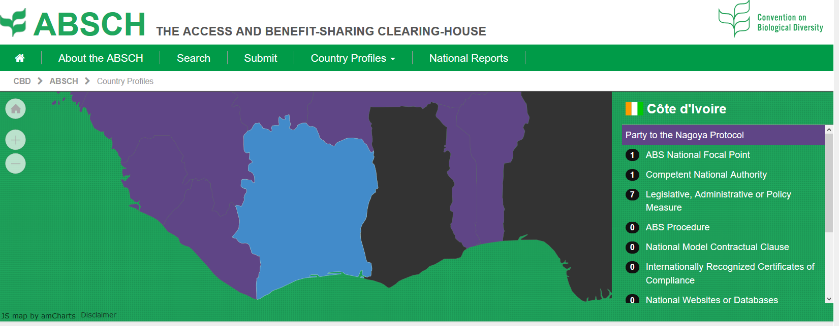
NP Compliant
Obtain PIC and MAT before collecting
Read the legislation on NP on the ABS-CH (https://absch.cbd.int)
Contact National focal point (nfp) NP
Establish PIC and MAT (if needed)
Keep communication if no reply from nfp
Start the collection
Obtain export papers (more needed than just NP)

Slide 4
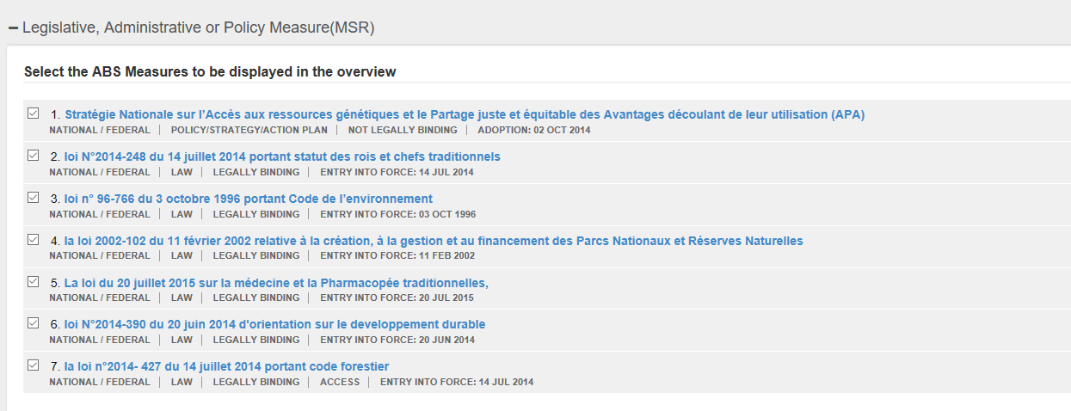
NP Compliant
Obtain PIC and MAT before collecting
Read the legislation on NP on the ABS-CH
Contact National focal point (nfp) NP
Establish PIC and MAT (if needed)
Keep communication if no reply from nfp
Start the collection
Obtain export papers (more needed than just NP)

Slide 5
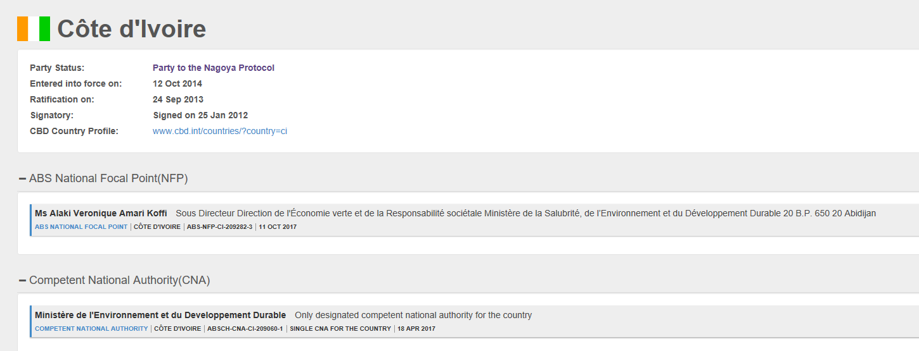
NP Compliant
Obtain PIC and MAT before collecting
Read the legislation on NP on the ABS-CH
Contact National focal point (nfp) NP
Establish PIC and MAT (if needed)
Keep communication if no reply from nfp
Start the collection
Obtain export papers (more needed than just NP)

Slide 6
NP Compliant
Obtain PIC and MAT before collecting
Read the legislation on NP on the ABS-CH
Contact National focal point (nfp) NP
Establish PIC and MAT (if needed)
Keep communication if no reply from nfp
Start the collection
Obtain usual export papers (more needed than just NP!)

Slide 7
Some Examples
Small questionnaire to visiting researchers
4 questions:
  Did you contact nfp 100 %
  Did he/she reply to you 100%
  Did you get the PIC and MAT 50%
  Did you leave material in Belgium up on your return 75%

Slide 8
Some Examples
Difficulties encountered:
Obtained documents are not clear and not useful to work with
Money request linked to obtain PIC and MAT
Material can’t be part of official collections
Material arrives too late for the researcher to work with

Slide 9
Some Examples

Slide 10
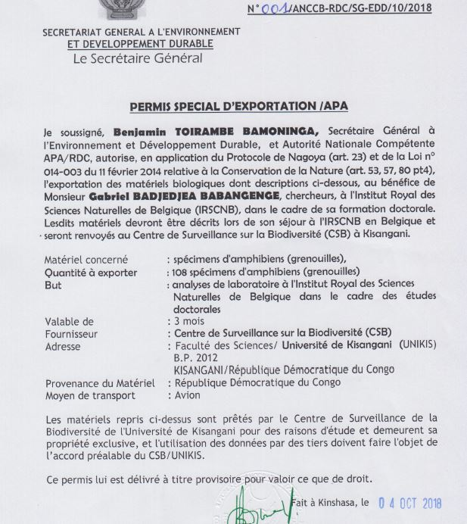
Some Examples

Slide 11
NP Compliant
Let Focal point NP from country of origin post PIC and MAT on the ABS CH
No real PIC and MAT obtained so far
none searchable on ABS-CH (there should be one by South Africa)

Slide 12
NP Compliant
NP documentation linked to the specimen in collections
RBINS prepared Nagoya section in collection database
Uploading PIC/MAT and documents from third party
Link to Internationaly recognized certificate of compliance (IRCC)
PIC/MAT for access to collections

Slide 13
NP Compliant
Ensure documentation easily accessible before permitting use of the specimen/material
Still waiting for Belgian legislation
Using classic MTA so far

Slide 14
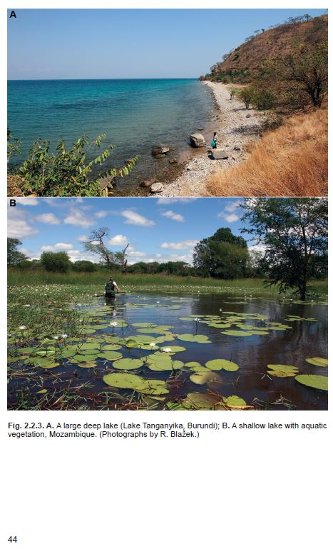
Thank
you
for
your
attention
Photo from:
Abc-taxa: vol18
© 2018

